Slide 1
1 paragraph + RF
What do know about graphic novels? Have you read any before? How about comics? What was the experience like? How do you think reading a graphic novel will differ from reading a novel?

Slide 2
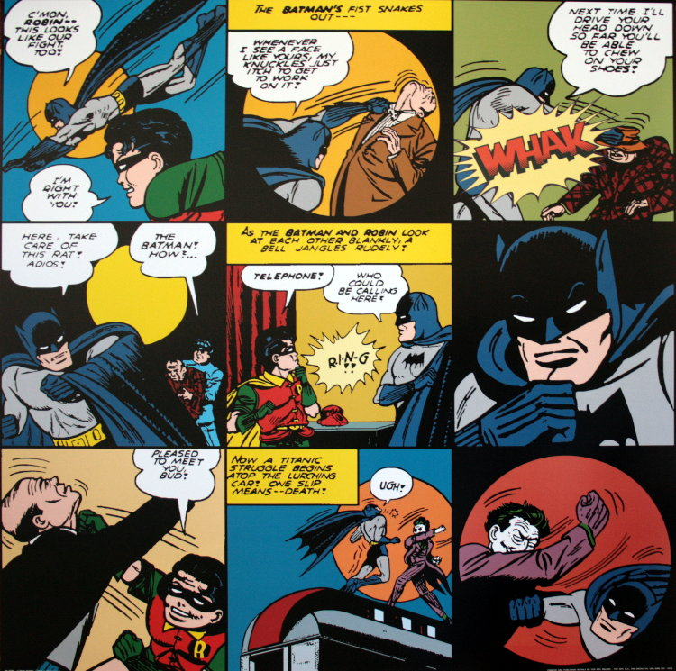
Graphic Novel Terms

Slide 3
Panel
A distinct segment of the comic containing image and text.

Slide 4
Frame
The Lines and borders that contain panels.

Slide 5
Gutter
The space between framed panels
Allows the viewer to Infer what happened between the panels. Lapses in time may be small or large.

Slide 6
Captions
Boxes that contain a variety of textual information

Slide 7
Captions

Slide 8
Speech balloons
*What characters say to each other.
*Each word balloon has a “tail” to let you know who is talking!

Slide 9
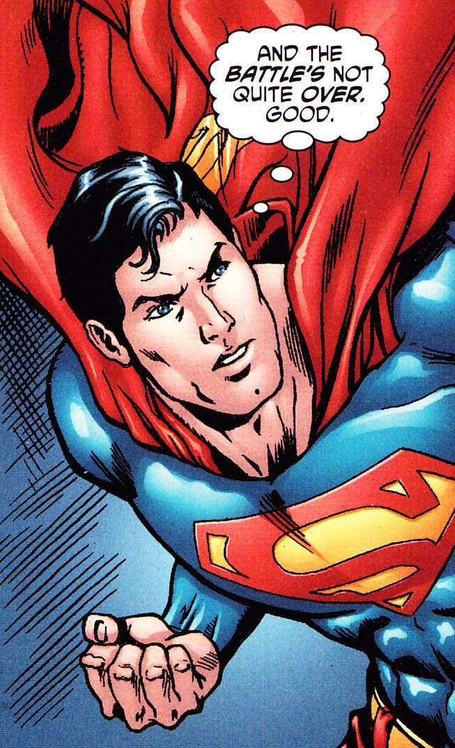
Thought Balloons

Slide 11
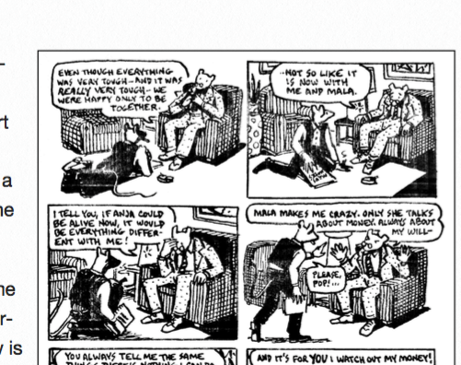
Frameless panels vs. panels w/ Frame
Notes:
Borderless- space, freedom, outside of time. Ex- “We’re happy only to be together.”→ a continuing feeling
Border- happening at an exact moment in time

Slide 12
Overlapping panels
Notes:
Shows a connection between feelings, events, word

Slide 13
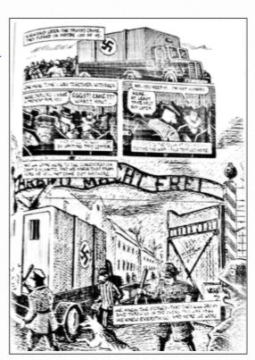
Panel Size
Notes:
Larger panels can emphasize significance of a moment, like when Vladek arrives in Auschwitz.

Slide 14
Special Effects Lettering- text set apart in order to draw attention to it.

Slide 15
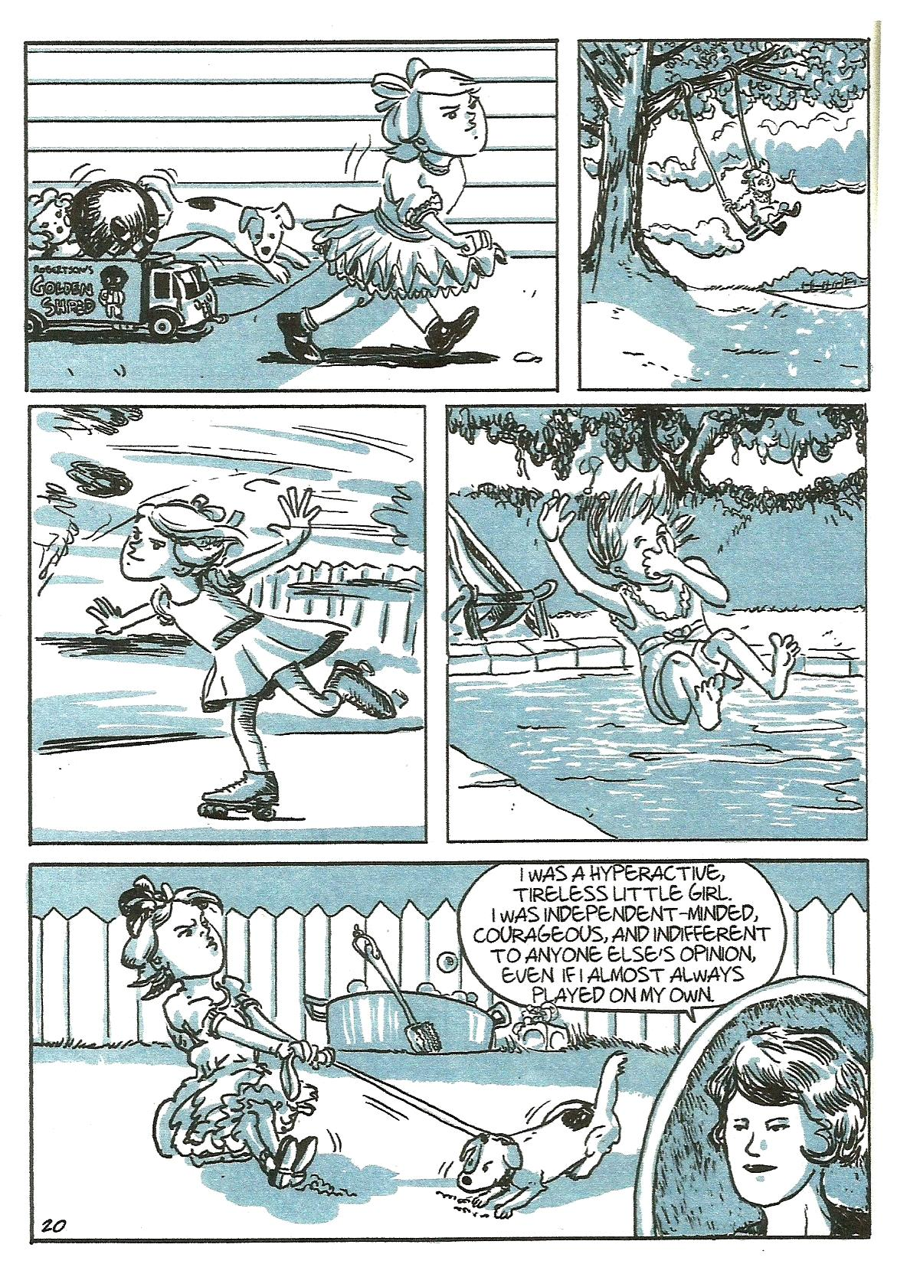
Silent panel- a panel with no captions or speech bubbles

Slide 16
Bleed- Image extends to or beyond the edge of the page

Slide 17
Foreground, midground, background

Slide 18
Foreground: Images in a panel closest to the viewer.
Midground: Images that appear in the middle of the panel. (most likely to look here first.)
Background: Images that appear in the distance.
* Off center images can create tension

Slide 19
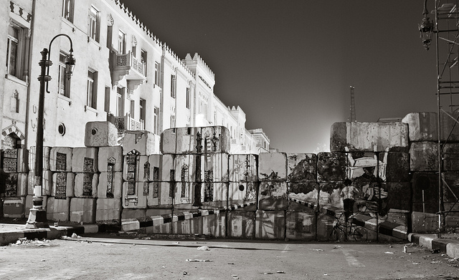
Graphic Weight
A term to describe how some images draw the eye more (often this is done with shading).

Slide 20
Faces, hands, figures- Show emotion through positioning and expression
Notes:
Hands over mouth- fear, shame, shyness
Feet turned in- embarrassment

Slide 21
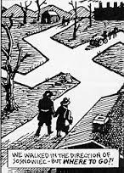
Symbol
An image or object used to represent something else like an idea or emotion.

