Slide 1
+ R.F
Describe your weekend by writing the following:
A simile
A metaphor
Personification

Slide 2
English 9
Poetic Devices
Adapted from: http://www.chaparralpoets.org/devices.pdf & http://highered.mheducation.com/sites/0072405228/student_view0/poetic_glossary.html

Slide 3
Write one paragraph
Would your rather be seen as serious all of the time (and never fun) or fun all of the time (and never serious). Explain your choice.

Slide 4
Author vs. Narrator
Author:
The writer of the text
Narrator:
The person (or thing) telling the story
This seems simple, but don’t confuse the two!
The narrator doesn’t speak for the author. The author may use a narrator to say something completely contrary to what he or she actually believes.

Slide 5
Tone vs. Mood
Tone:
Implied attitude of the writer towards the subject
Ex: bitter, loving, satirical
Mood:
The way a text makes the reader feel
Ex: melancholy, dreary, romantic, hopeful

Slide 6
Stanza
A collection of lines in a poem (can also be a stand-alone line). You can think of this somewhat like a paragraph with an essay.
Ex: Some say the world will end in fire,
Some say in ice.
From what I've tasted of desire
I hold with those who favor fire.
But if it had to perish twice,
I think I know enough of hate
To say that for destruction ice
Is also great
And would suffice.
← Robert Frost’s one stanza poem “Fire and Ice”

Slide 7
Simile
A comparison between two things using “like” or “as”
Ex: “You’re as cuddly as a cactus, you’re as slimy as an eel, Mr. Gri---inch!”
Her voice was like nails on a chalkboard.

Slide 8
Metaphor
A direct comparison between two unlike things, stating that one is the other or does the action of the other
Ex: Love is a fire.
I am a china shop and you are a bull.

Slide 9
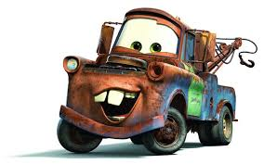
Personification
Giving inanimate objects or abstract concepts living and animate qualities
Ex: The days crept by slowly.
The leaves waved hello to us.

Slide 10
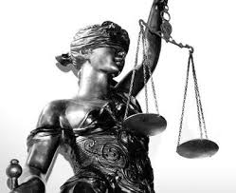
Symbol
An object that represents something else
Ex: lion as a symbol of courage, heart as a symbol of love, “blind justice”
Not just a weird woman with a blindfold--her image is full of symbolism for our justice system (female = gentleness; blind = fair; scales = thoughtful; sword = punishment)

Slide 11
Alliteration
Repeated consonants at the beginning of words placed next to one another
Ex: Curious crocodiles, fast and furious

Slide 12
Denotation
The dictionary definition of a word
Ex: Dove: A stocky bird with a small head, short legs, and cooing voice, very similar to but generally smaller than a pigeon.

Slide 13
Connotation
The emotional, cultural, and psychological overtones of a word apart from its literal definition.
Ex: Dove: a symbol of peace.

Slide 14
Allusion
A brief reference to some person, historical event, work of art, or Biblical or mythological situation or character.
Ex: Uncle Sam, Romeo

Slide 15
Hyperbole
An outrageous exaggeration used for effect
Ex: He weighs a ton. I’m so hungry I could eat a cow.

Slide 16
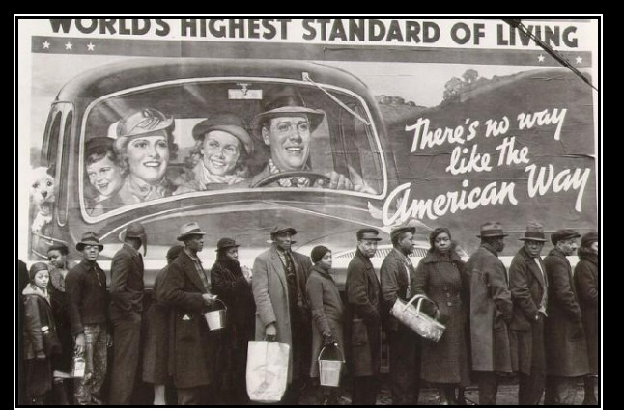
Irony
A contradictory statement or situation to reveal a reality different from what appears to be true.

Slide 17
Enjambment
Definition: A sentence in poetry that continues beyond the line break
Example:
It is a beauteous evening, calm and free,
The holy time is quiet as a Nun
Breathless with adoration; the broad sun
Is sinking down in its tranquility

Slide 18
Theme
The larger idea or concept that the work may represent
Ex: Friendship, love, isolation, childhood
Ex: Harry Potter -- the power of love and friendship over fear

Slide 19
Motif
Images, ideas, sounds, and words that help to explain the central idea or theme of a literary work.
Ex: colors, repetition of objects

Slide 20
Juxtaposition
Two or more ideas placed close to one another in order to draw comparisons
Ex: light & dark, good & evil

Slide 21
Rhyme
Words that have different beginning sounds but whose endings sound alike
Ex: Time/lime, time/line (slant rhyme)

Slide 22
Foreshadowing
Hints as to what will come in the text
Ex: A black cat crosses a character’s path and soon after he dies.
Ex: A character is deathly afraid of water since childhood and dies by drowning (also ironic).

Slide 23
https://www.ereadingworksheets.com/figurative-language/figurative-language-worksheets/

